Slide 1
Hi, I’m Josh (Yehoshua) Friedlander
Here’s some stuff about me

Slide 2
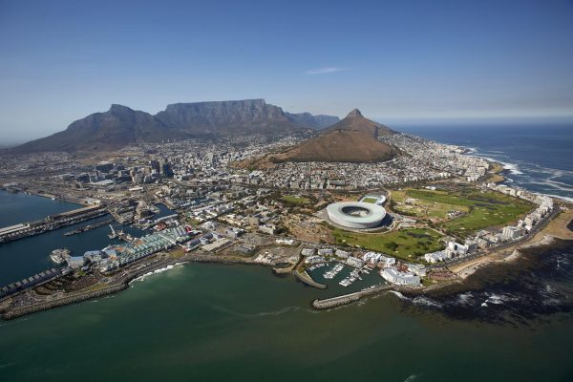
I’m from Cape Town, South Africa.
I moved to Johannesburg at age six, and moved to Israel after high school, in 2008

Slide 3
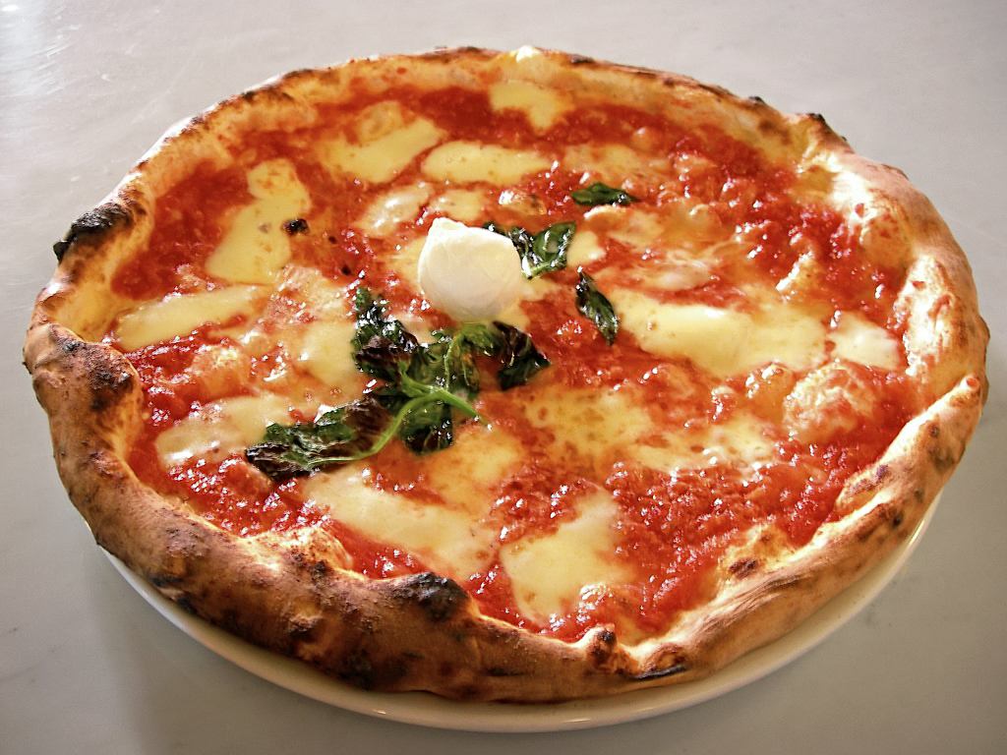
My undergrad was in Accounting and Information Systems and I’ve worked as an economist and a financial analyst (and a pizza maker)

Slide 4
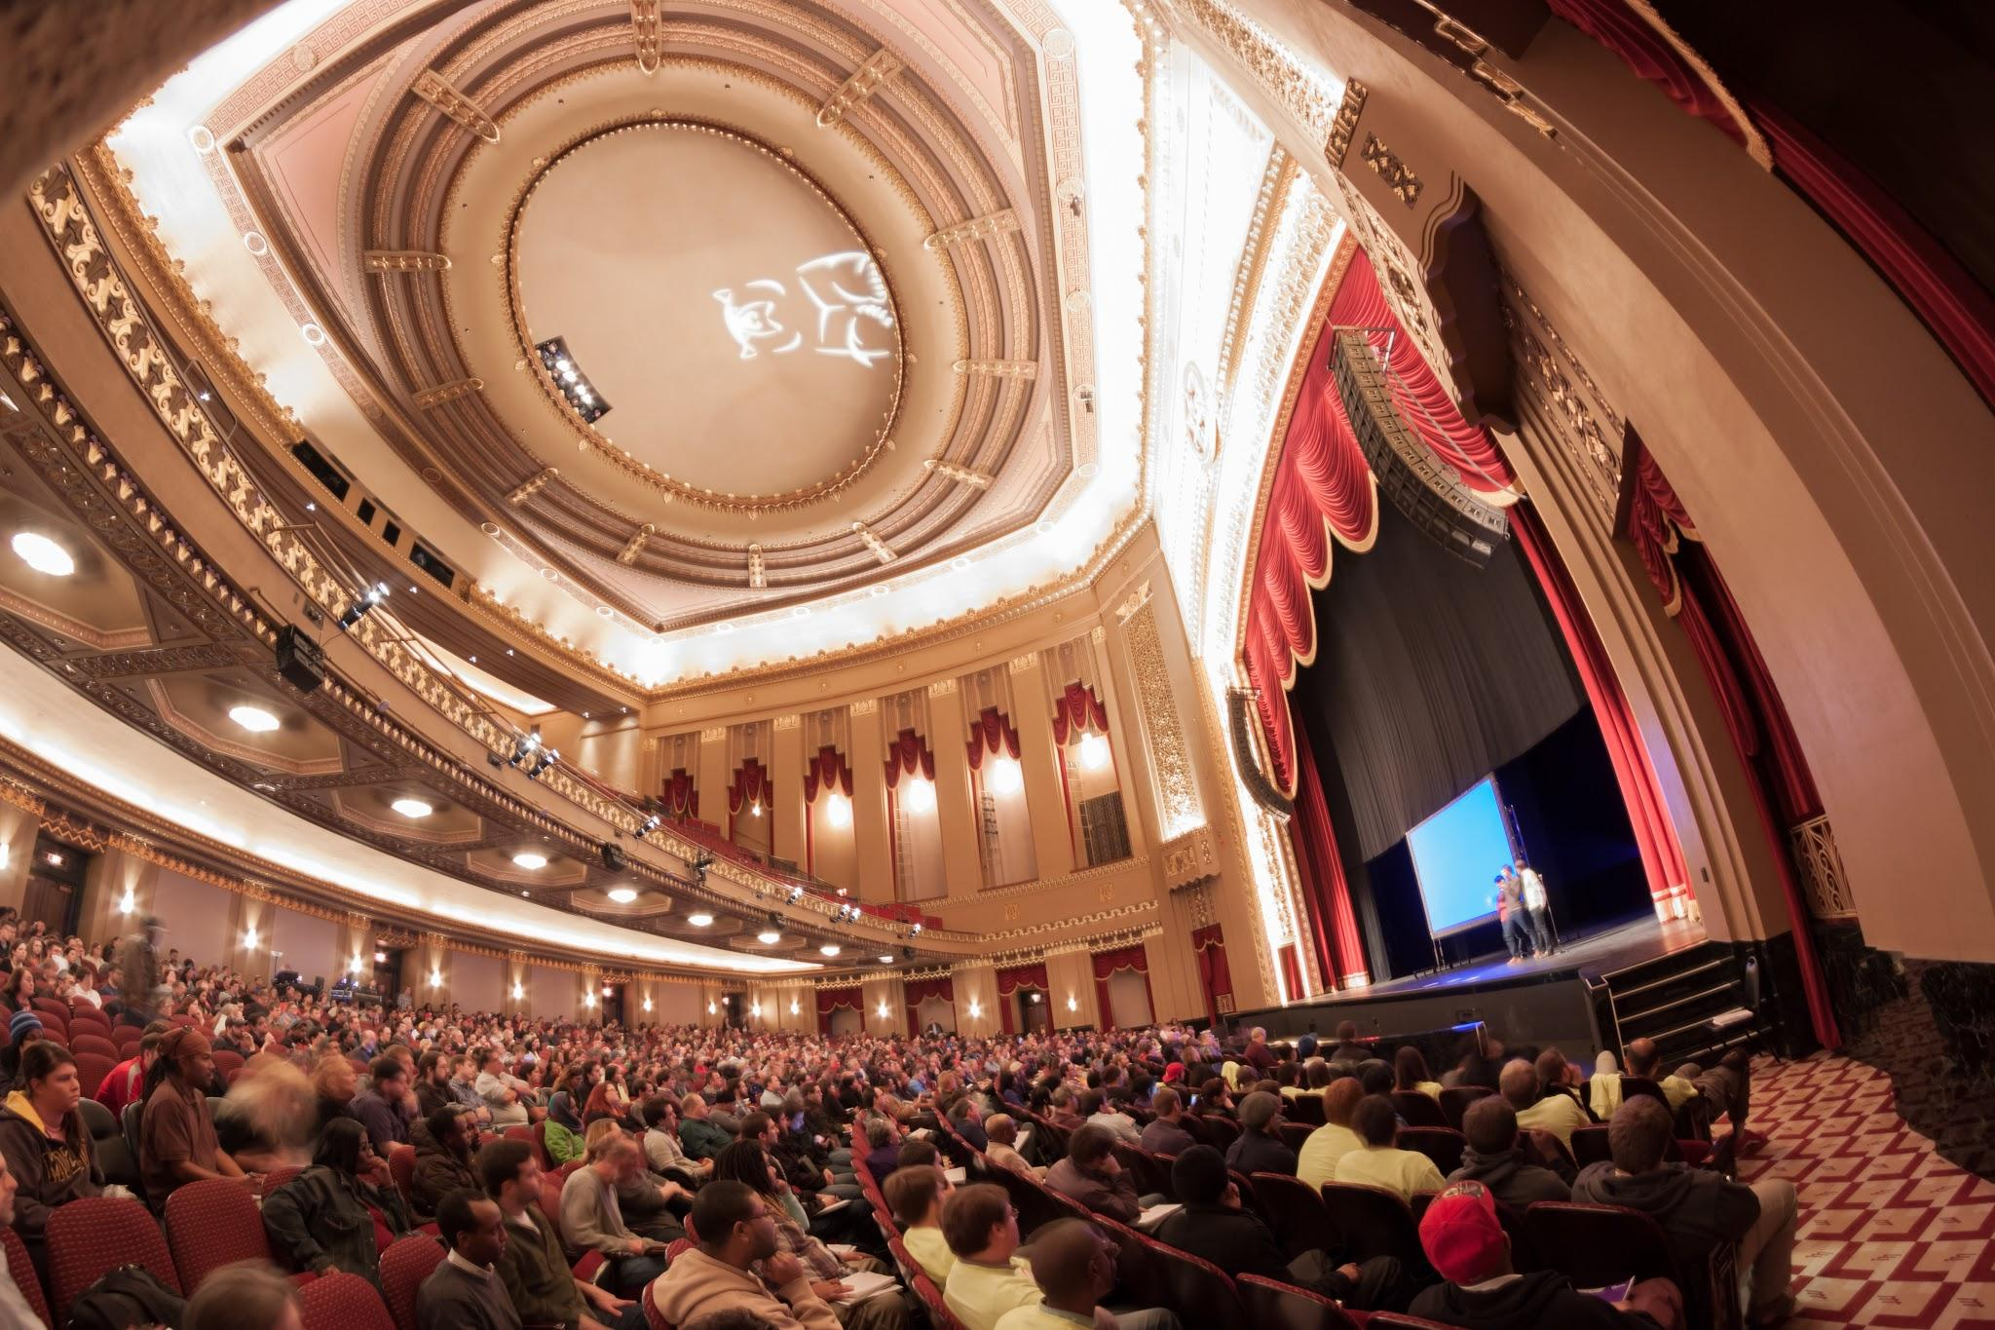
I got interested in coding via on online class called CS50
I’ve always been interested in
ways to analyse, mine and
present data

Slide 5

Looking forward to meeting all of the ISRAEL TECH CHALLENGERS in the next ten months!

